Slide 1
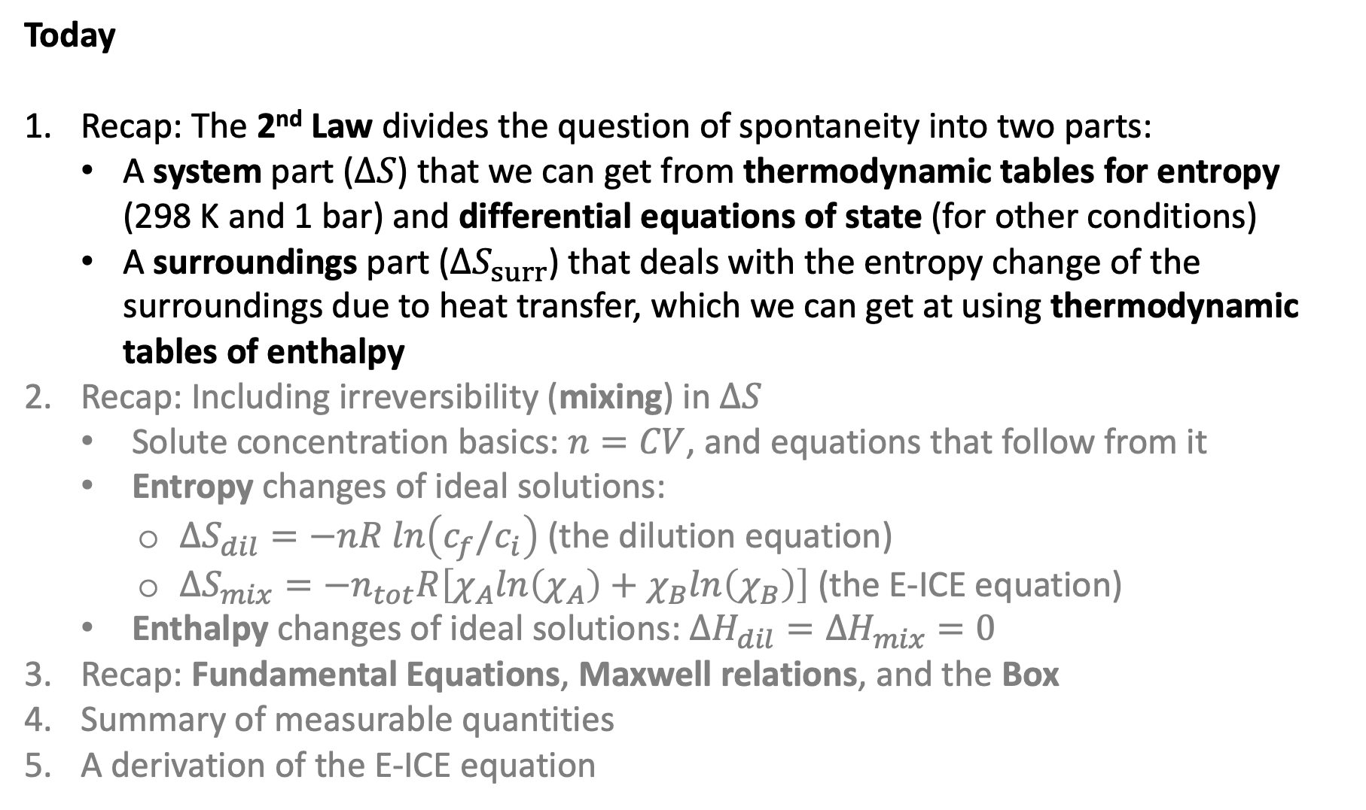
Today
Recap: The 2nd Law divides the question of spontaneity into two parts:
A system part ($∆S$) that we can get from thermodynamic tables for entropy (298 K and 1 bar) and differential equations of state (for other conditions)
A surroundings part ($∆S_{surr}$) that deals with the entropy change of the surroundings due to heat transfer, which we can get at using thermodynamic tables of enthalpy
Recap: Including irreversibility (mixing) in $∆S$
Solute concentration basics: $n=CV$, and equations that follow from it
Entropy changes of ideal solutions:
$∆S_{dil}=−nR ln\left(c_{f}/c_{i}\right)$ (the dilution equation)
$∆S_{mix}=−n_{tot}R\left[χ_{A}ln\left(χ_{A}\right)+χ_{B}ln\left(χ_{B}\right)\right]$ (the E-ICE equation)
Enthalpy changes of ideal solutions: $∆H_{dil}=∆H_{mix}=0$
Recap: Fundamental Equations, Maxwell relations, and the Box
Summary of measurable quantities
A derivation of the E-ICE equation

Slide 2
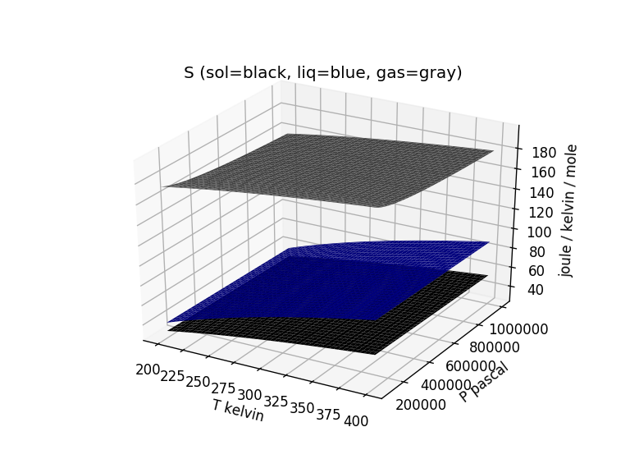
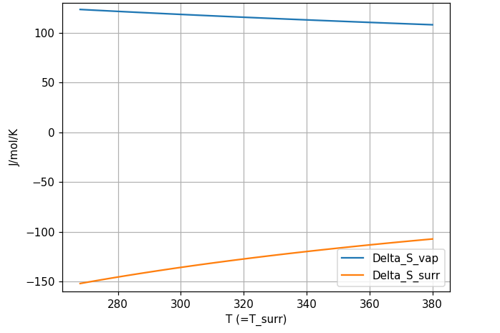



Two parts of the entropy that determine the boiling temperature (of water)
$$∆S_{vap}$$
$$∆S_{vap}$$
$$∆S_{surr}$$

Slide 3
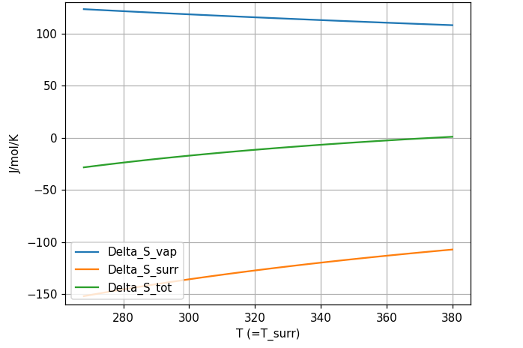
Two parts of the entropy that determine the boiling temperature (of water)
$$∆S_{vap}$$
$$∆S_{vap}$$
$$∆S_{surr}$$

Slide 4
Two parts of the entropy that determine the boiling temperature (of water)
$$∆S_{vap}$$
$$∆S_{vap}$$
$$∆S_{surr}$$

Slide 5
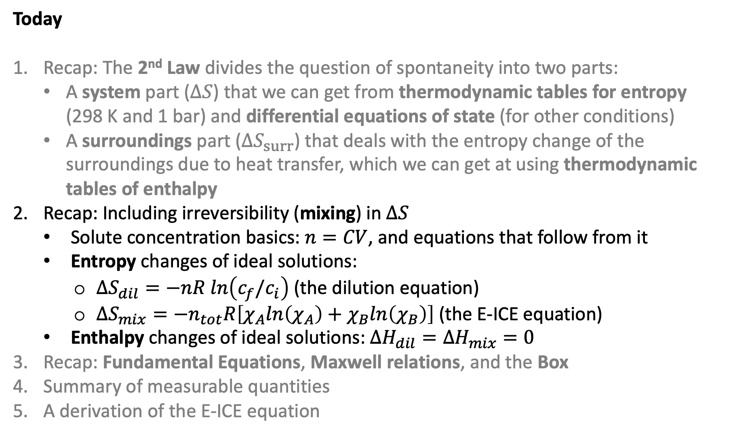
Today
Recap: The 2nd Law divides the question of spontaneity into two parts:
A system part ($∆S$) that we can get from thermodynamic tables for entropy (298 K and 1 bar) and differential equations of state (for other conditions)
A surroundings part ($∆S_{surr}$) that deals with the entropy change of the surroundings due to heat transfer, which we can get at using thermodynamic tables of enthalpy
Recap: Including irreversibility (mixing) in $∆S$
Solute concentration basics: $n=CV$, and equations that follow from it
Entropy changes of ideal solutions:
$∆S_{dil}=−nR ln\left(c_{f}/c_{i}\right)$ (the dilution equation)
$∆S_{mix}=−n_{tot}R\left[χ_{A}ln\left(χ_{A}\right)+χ_{B}ln\left(χ_{B}\right)\right]$ (the E-ICE equation)
Enthalpy changes of ideal solutions: $∆H_{dil}=∆H_{mix}=0$
Recap: Fundamental Equations, Maxwell relations, and the Box
Summary of measurable quantities
A derivation of the E-ICE equation

Slide 6
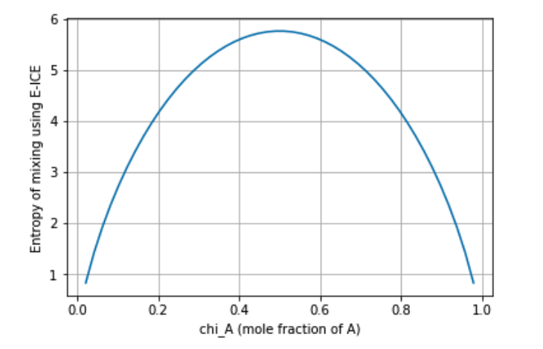

Entropy of mixing for varying volumes
1 L total; A and B both initially at 1 M concentration
A
B
A
B
A
B
$$5.8\frac{J}{mol K}$$
Get the most entropy of mixing when it’s equal moles of solutes (or equal volumes, if all solutes are originally at 1 M concentration.

Slide 7
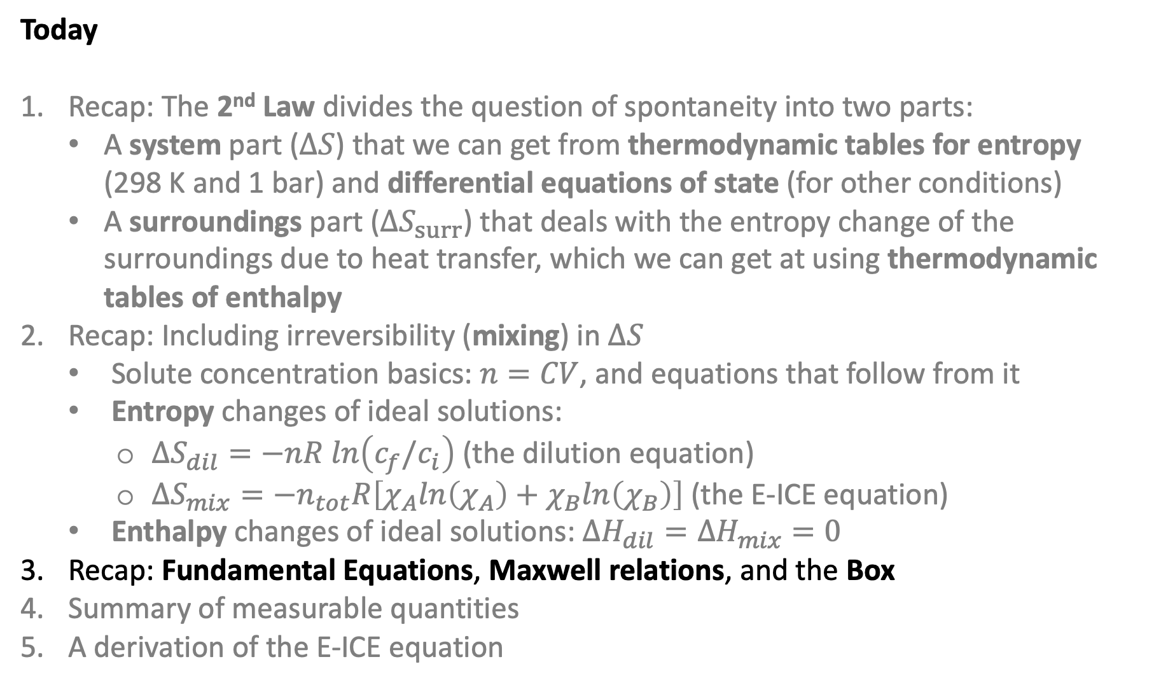
Today
Recap: The 2nd Law divides the question of spontaneity into two parts:
A system part ($∆S$) that we can get from thermodynamic tables for entropy (298 K and 1 bar) and differential equations of state (for other conditions)
A surroundings part ($∆S_{surr}$) that deals with the entropy change of the surroundings due to heat transfer, which we can get at using thermodynamic tables of enthalpy
Recap: Including irreversibility (mixing) in $∆S$
Solute concentration basics: $n=CV$, and equations that follow from it
Entropy changes of ideal solutions:
$∆S_{dil}=−nR ln\left(c_{f}/c_{i}\right)$ (the dilution equation)
$∆S_{mix}=−n_{tot}R\left[χ_{A}ln\left(χ_{A}\right)+χ_{B}ln\left(χ_{B}\right)\right]$ (the E-ICE equation)
Enthalpy changes of ideal solutions: $∆H_{dil}=∆H_{mix}=0$
Recap: Fundamental Equations, Maxwell relations, and the Box
Summary of measurable quantities
A derivation of the E-ICE equation

Slide 8
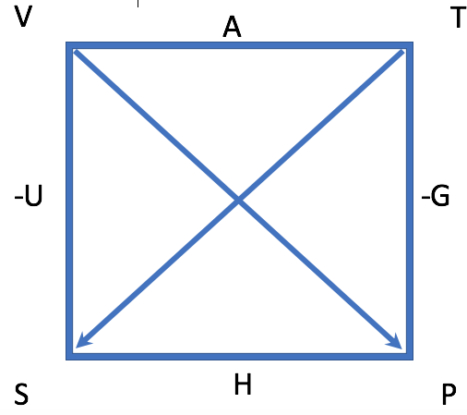
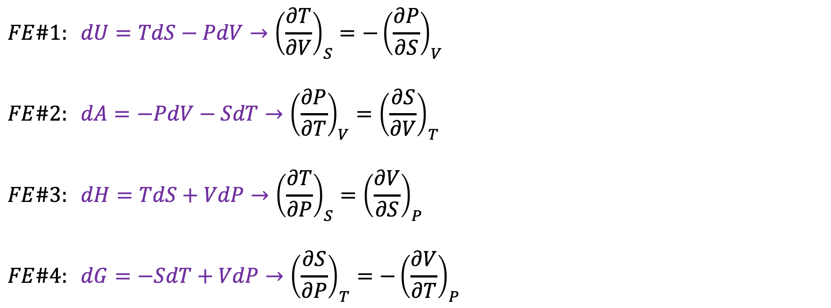
Fundamental equations, Maxwell Relations, and the Box
$$FE\#1: dU=TdS−PdV→{\left(\frac{∂T}{∂V}\right)}_{S}=−{\left(\frac{∂P}{∂S}\right)}_{V}$$
$$FE\#2: dA=−PdV−SdT→{\left(\frac{∂P}{∂T}\right)}_{V}={\left(\frac{∂S}{∂V}\right)}_{T}$$
$$FE\#3: dH=TdS+VdP→{\left(\frac{∂T}{∂P}\right)}_{S}={\left(\frac{∂V}{∂S}\right)}_{P}$$
$$FE\#4: dG=−SdT+VdP→{\left(\frac{∂S}{∂P}\right)}_{T}=−{\left(\frac{∂V}{∂T}\right)}_{P}$$
Already saw two mysteries these unlocked … next we’ll go for Gibbs

Slide 9
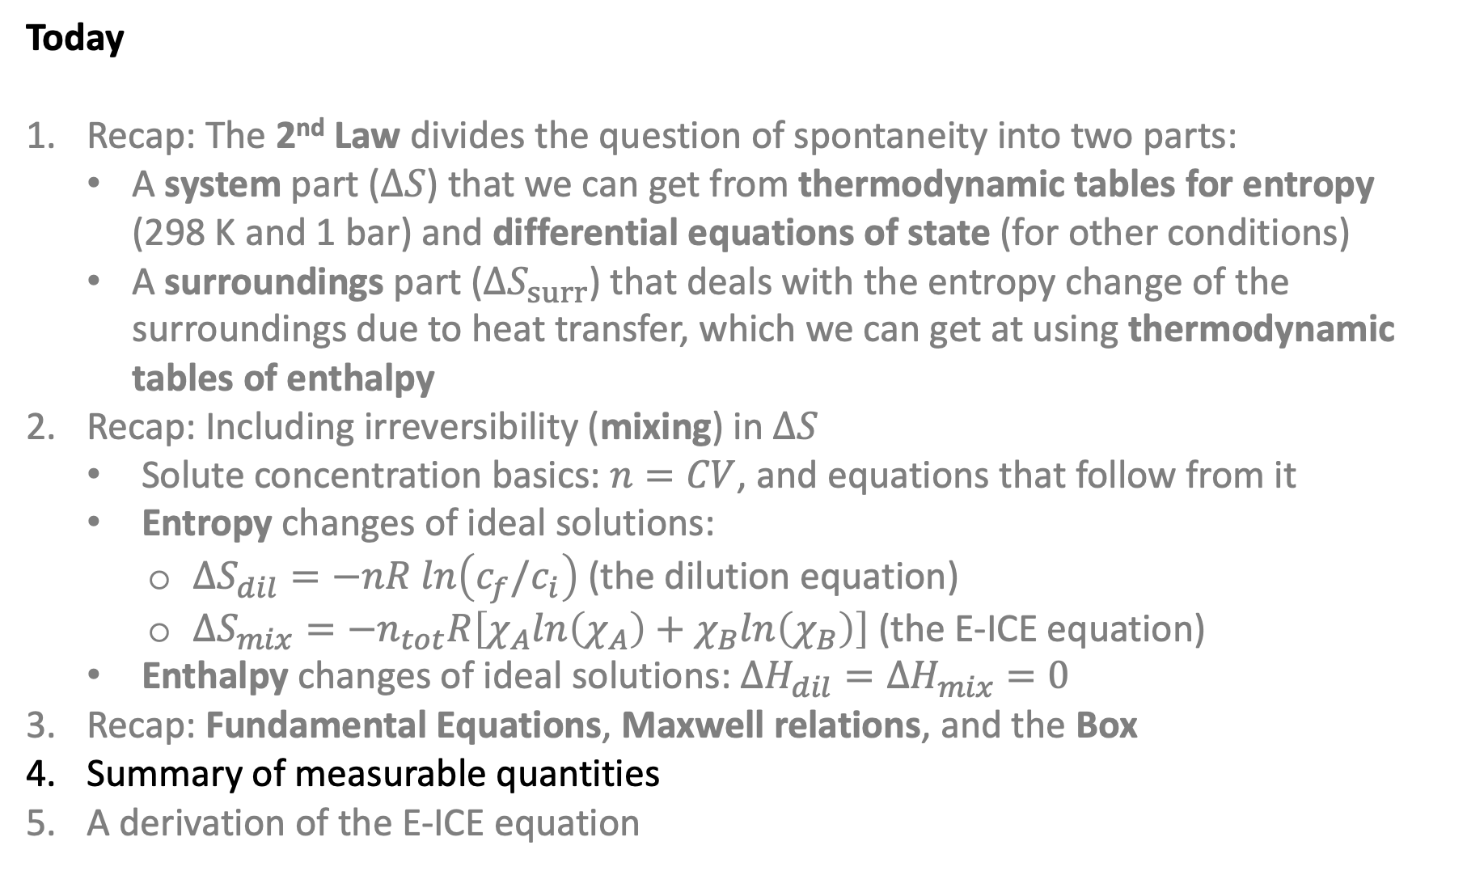
Today
Recap: The 2nd Law divides the question of spontaneity into two parts:
A system part ($∆S$) that we can get from thermodynamic tables for entropy (298 K and 1 bar) and differential equations of state (for other conditions)
A surroundings part ($∆S_{surr}$) that deals with the entropy change of the surroundings due to heat transfer, which we can get at using thermodynamic tables of enthalpy
Recap: Including irreversibility (mixing) in $∆S$
Solute concentration basics: $n=CV$, and equations that follow from it
Entropy changes of ideal solutions:
$∆S_{dil}=−nR ln\left(c_{f}/c_{i}\right)$ (the dilution equation)
$∆S_{mix}=−n_{tot}R\left[χ_{A}ln\left(χ_{A}\right)+χ_{B}ln\left(χ_{B}\right)\right]$ (the E-ICE equation)
Enthalpy changes of ideal solutions: $∆H_{dil}=∆H_{mix}=0$
Recap: Fundamental Equations, Maxwell relations, and the Box
Summary of measurable quantities
A derivation of the E-ICE equation

Slide 10
Summary of measurable quantities

Slide 11
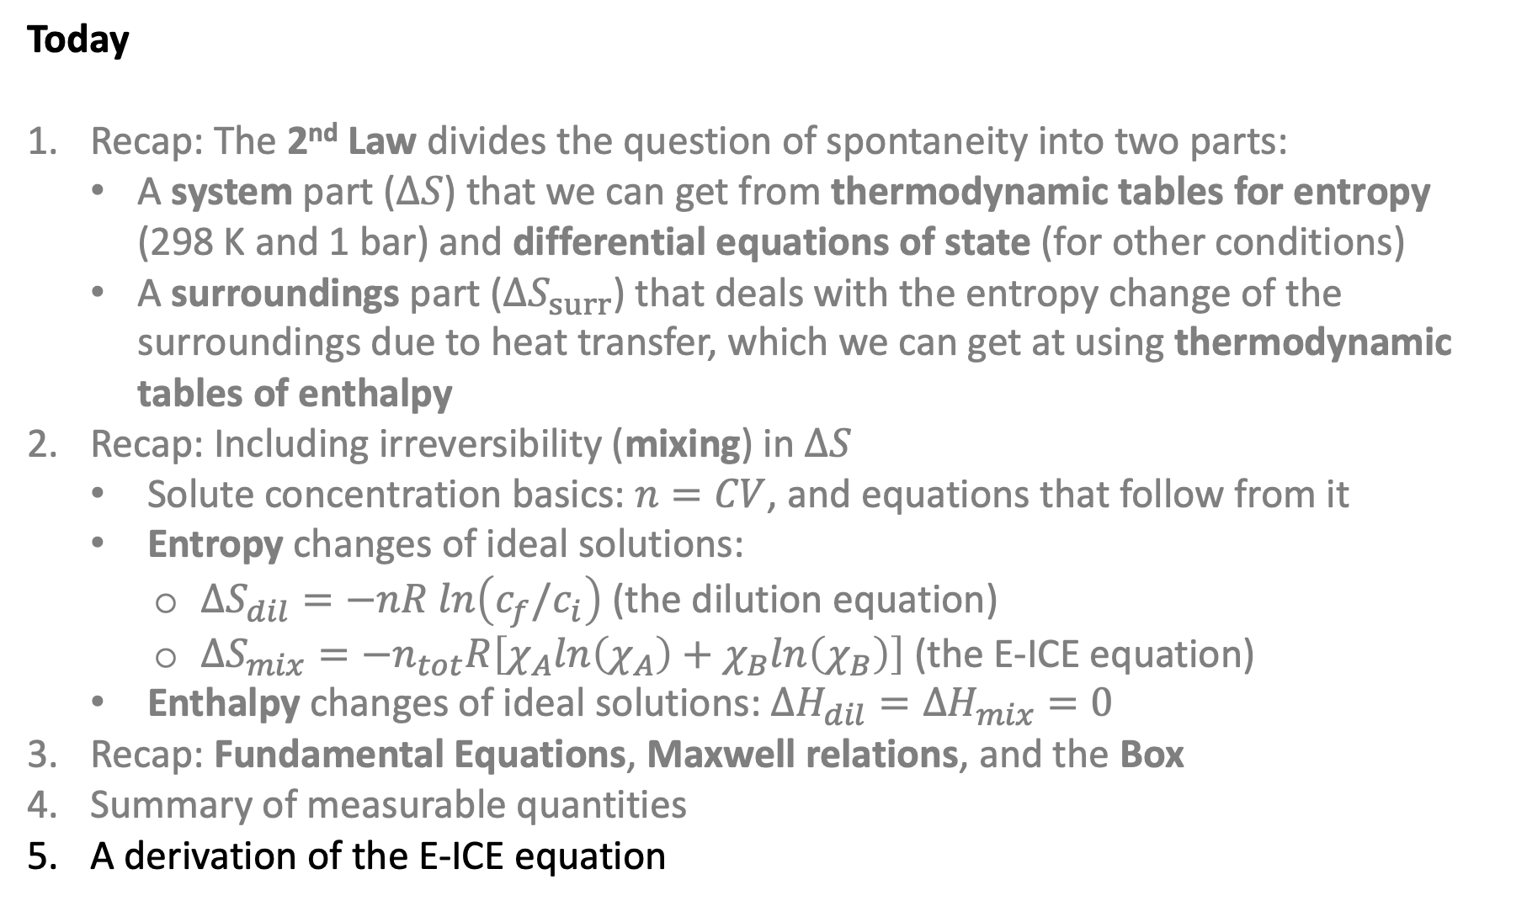
Today
Recap: The 2nd Law divides the question of spontaneity into two parts:
A system part ($∆S$) that we can get from thermodynamic tables for entropy (298 K and 1 bar) and differential equations of state (for other conditions)
A surroundings part ($∆S_{surr}$) that deals with the entropy change of the surroundings due to heat transfer, which we can get at using thermodynamic tables of enthalpy
Recap: Including irreversibility (mixing) in $∆S$
Solute concentration basics: $n=CV$, and equations that follow from it
Entropy changes of ideal solutions:
$∆S_{dil}=−nR ln\left(c_{f}/c_{i}\right)$ (the dilution equation)
$∆S_{mix}=−n_{tot}R\left[χ_{A}ln\left(χ_{A}\right)+χ_{B}ln\left(χ_{B}\right)\right]$ (the E-ICE equation)
Enthalpy changes of ideal solutions: $∆H_{dil}=∆H_{mix}=0$
Recap: Fundamental Equations, Maxwell relations, and the Box
Summary of measurable quantities
A derivation of the E-ICE equation

Slide 12

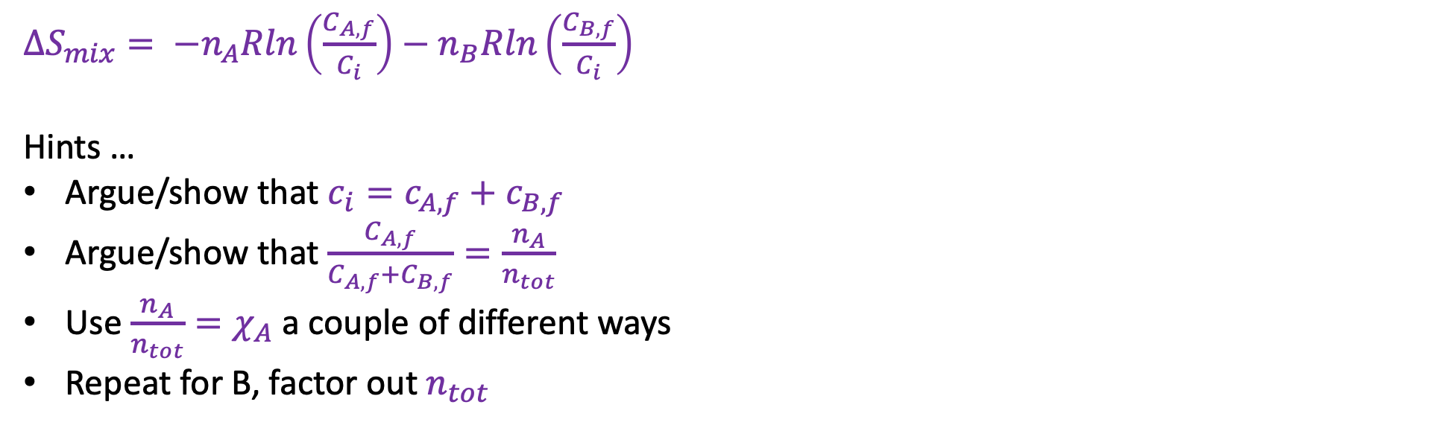



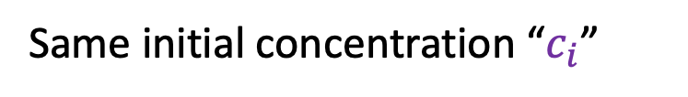
A derivation of the “equal initial concentrations” equation for entropy of mixing
$$n_{A}$$
$$c_{B,f}$$
$$n_{B}$$
$$c_{A,f}$$
Same initial concentration “$c_{i}$”
$∆S_{mix}= −n_{A}Rln\left(\frac{C_{A,f}}{C_{i}}\right)−n_{B}Rln\left(\frac{C_{B,f}}{C_{i}}\right)$
Hints …
Argue/show that $c_{i}=c_{A,f}+c_{B,f}$
Argue/show that $\frac{C_{A,f}}{C_{A,f}+C_{B,f}}=\frac{n_{A}}{n_{tot}}$
Use ${\frac{n_{A}}{n_{tot}}=χ}_{A}$ a couple of different ways
Repeat for B, factor out $n_{tot}$
$∆S_{mix}=−n_{tot}R\left[χ_{A}ln\left(χ_{A}\right)+χ_{B}ln\left(χ_{B}\right)\right]$

